Slide 1


Automating Azure: Infrastructure as Code in Azure
Shawn Weisfeld
Sr. Cloud Solution Architect
Microsoft

Slide 2

About Me
Shawn Weisfeld
Sr. Cloud Solution Architect
Microsoft – One Commercial Partner Technical Team
sweisfel@microsoft.com
Austin, TX
Get this PPT & Code Samples: https://bit.ly/2Mo3t9S

Slide 3

UserGroup.tv your source for FREE videos of technical community content online.
975+ hours of content donated by our local User Group speakers.
Check it out today @
http://www.UserGroup.tv

Slide 4


Slide 5
What is Infrastructure as Code (IaC)?
Management of deployed resources in a descriptive model, leveraging the same versioning techniques the developers use for source code.
Changes are made in the model and then the entire model is redeployed.
No manual configuration of environments
More Info: https://docs.microsoft.com/en-us/azure/devops/learn/what-is-infrastructure-as-code

Slide 6
Goals of IaC
Eliminate Environment Drift
Eliminate Inconsistency between Environments
Deployments are repeatable, automatable, and fully documented

Slide 7
Popular IaC Options in Azure
Azure Resource Management (ARM) Templates
Azure CLI/Posh Scripts
HashiCorp Terraform - https://www.terraform.io/
Chef - https://www.chef.io/
RedHat Ansible - https://www.ansible.com/
Puppet - https://puppet.com/

Slide 8


Slide 9
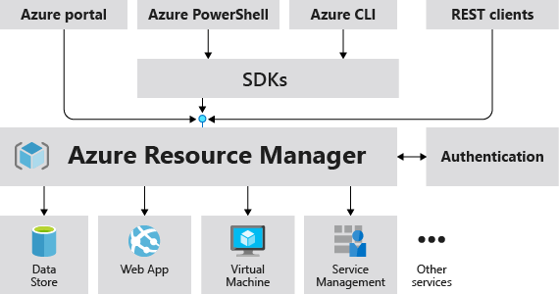
What is Azure Resource Management (ARM)?
Other Azure Resources
More Info: https://docs.microsoft.com/en-us/azure/azure-resource-manager/resource-group-overview

Slide 10
Vocab List
Resource – any item that can be managed in Azure (i.e. VM, storage, network, db, etc.)
Resource Group (RG) – a container used to group resources
Resource Provider – a service that supplies resources
ARM Template – Json doc that defines resources to deploy to a Resource group

Slide 11
Consider when Defining your RG’s
All the resources in your group should share the same lifecycle. You deploy, update, and delete them together.
Each resource can only exist in one resource group.
You can add or remove a resource to a resource group at any time.
You can move a resource from one resource group to another group.
A resource group can contain resources that are located in different regions.
A resource group can be used to scope access control for administrative actions.
A resource can interact with resources in other resource groups.

Slide 12
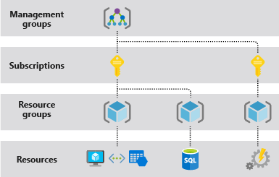
Scope in Azure

Slide 13



Azure Structure
Account and enterprise agreement
Subscription(s)
Resource group
Resource group
SQL
SQL
Role-based access control
Tags
Azure Resource Manager policy
Templates

Slide 14
The Importance of Idempotence
A deployment always sets the target environment into the same configuration, regardless of the environment’s starting state.
Achieved by either:
Upgrading
ARM Templates
Destroy & Create
ARM Templates & Azure CLI/Posh

Slide 15
Demo:
Create a SQL Server with the CLI
More Info:
https://docs.microsoft.com/en-us/azure/sql-database/scripts/sql-database-create-and-configure-database-cli

Slide 16
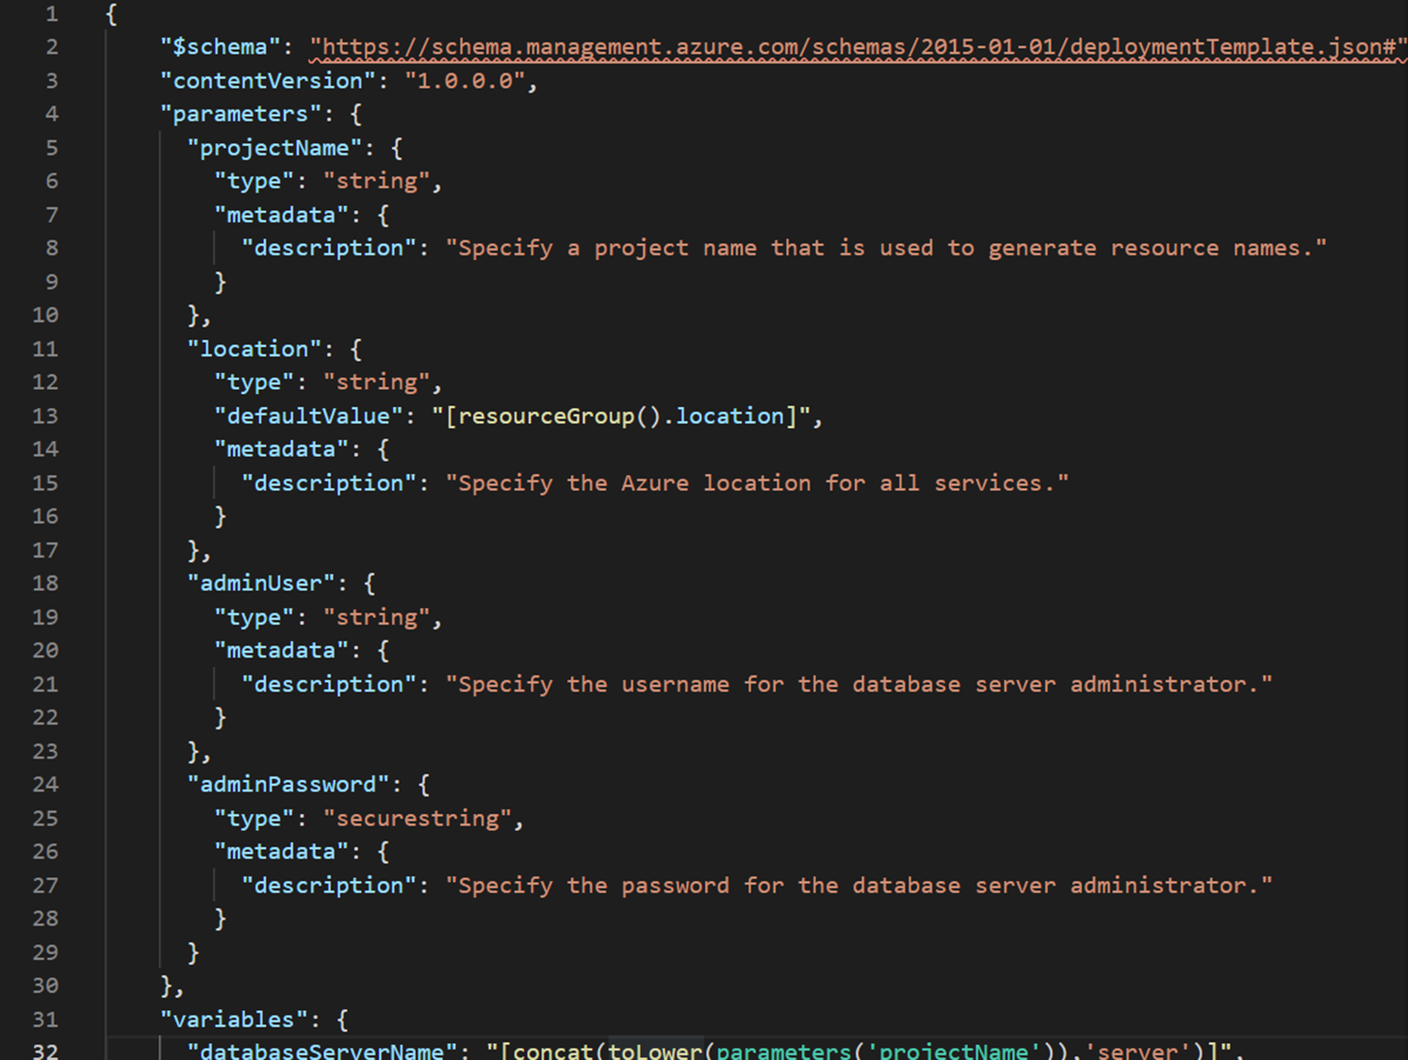
Demo:
Create a SQL Server with the ARM
More Info:
https://docs.microsoft.com/en-us/azure/sql-database/sql-database-single-database-get-started-template

Slide 17
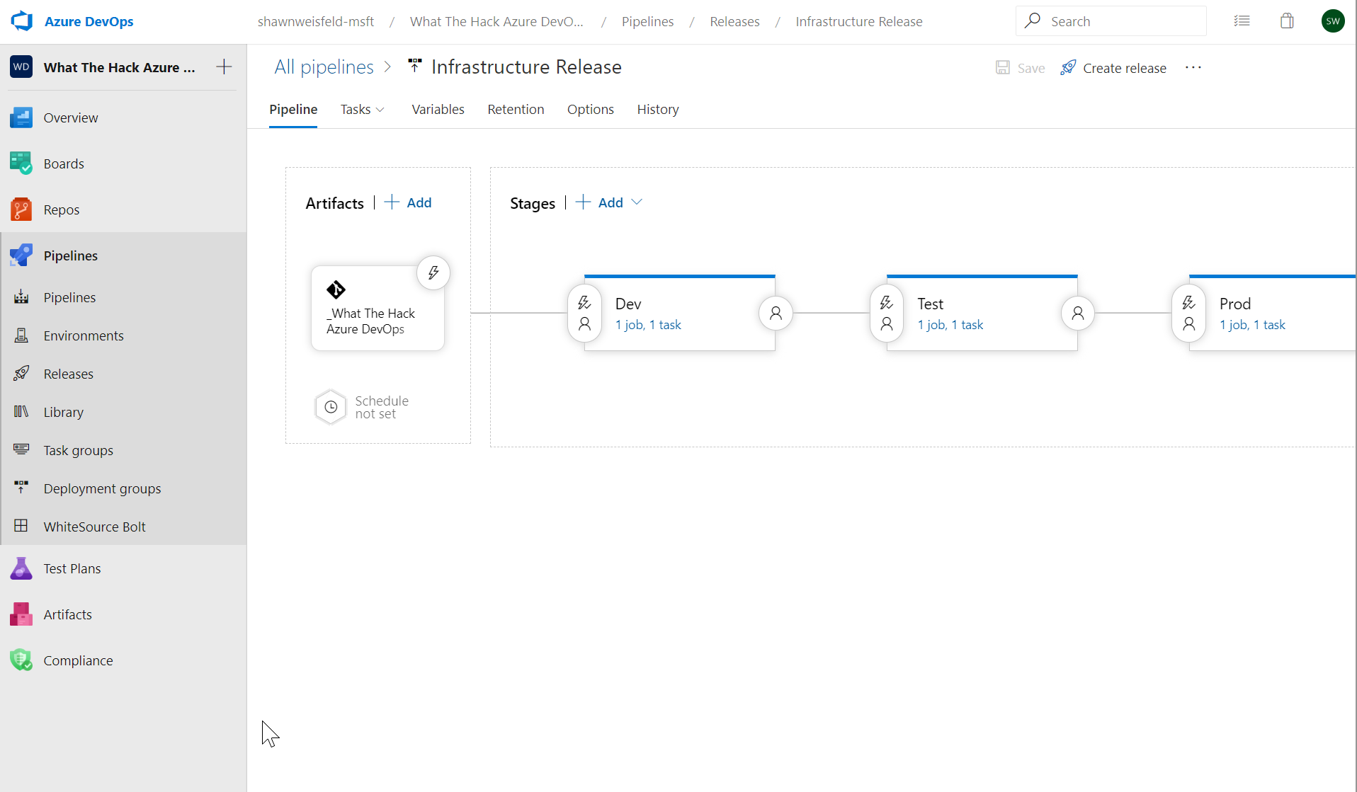
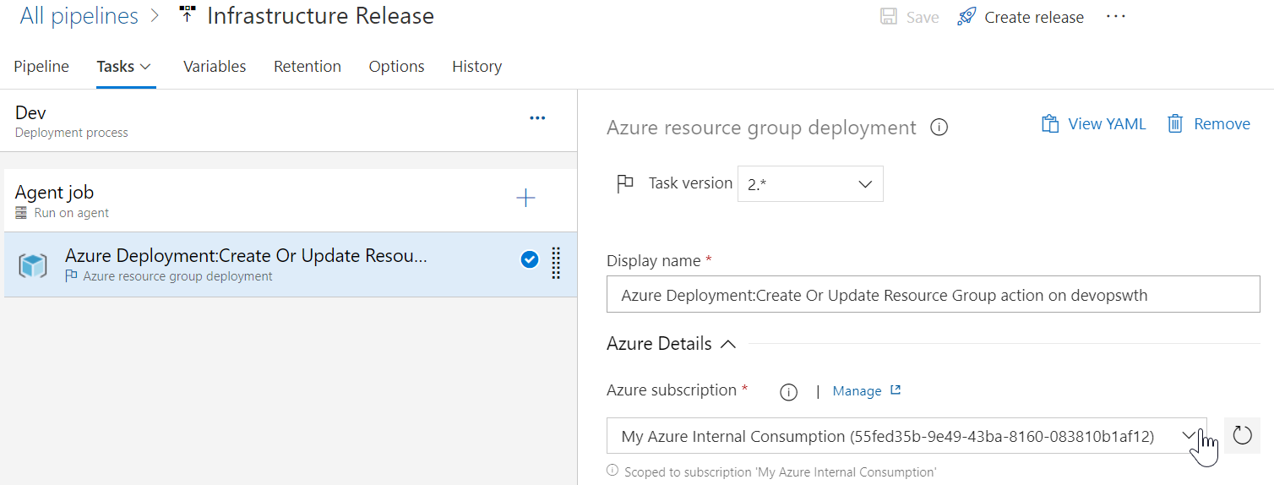
Demo:
Automate Template delivery with Azure DevOps

Slide 18
Helpful ARM docs
Azure Docs
https://docs.microsoft.com/en-us/azure/azure-resource-manager/resource-group-authoring-templates
Azure Learning Path - Administer infrastructure resources in Azure
https://docs.microsoft.com/en-us/learn/paths/administer-infrastructure-resources-in-azure/

Slide 19
Tools to help you build ARM templates
Extensions for VS Code
ARM Tools
ARM Snippets

Slide 20
Sample ARM
Resources.azure.com
Export an ARM Template from the portal
Azure Quickstart Templates
https://azure.microsoft.com/en-us/resources/templates/

Slide 21
Thank you!
Shawn Weisfeld
Sr. Cloud Solution Architect
Microsoft – One Commercial Partner Technical Team
sweisfel@microsoft.com
Austin, TX
Get this PPT & Code Samples: https://bit.ly/2Mo3t9S

